Slide 1
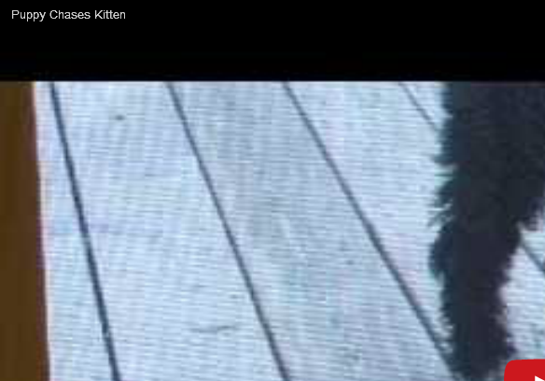
Play YouTube Video on a Slide
The video placeholder might look blank to start with.
Go into Slide Show view and click on the placeholder to play the video.

